Slide 1
Theory of Computation
CSE 3101
Lecture # 09
Md. Manowarul Islam
Lecturer, Dept of CSE
Jagannath University

Slide 2
State Reduction by Set Partitioning
The set partitioning technique is similar to one used for partitioning people into groups based on their responses to questionnaire.
The following slides show the detailed steps for computing equivalent state sets of the starting DFA and constructing the corresponding reduced DFA.

Slide 3
Example
b
a
a
3
a
1
b
a
0
4
a
2
b
b
b
5
b
a

Slide 4
Example
Step 0: Partition the states into two groups accepting and non-accepting.
Step 1: Get the response of each state for each input symbol.
P1
P2
b
a
a
3
{ 3, 4, 5 }
{ 0, 1, 2 }
a
1
a
0
b
4
a
2
b
b
b
5
b
a

Slide 5
Example
Step 1: Get the response of each state for each input symbol.
P1
P2
P2
P1
b
a
a
3
a
a
3(P₁)
3 | 4 | 5
0 | 1 | 2
1
a
0
b
4
b
a
2
b
b
b
5
b
a

Slide 6
Example
Step 1: Get the response of each state for each input symbol.
P1
P2
P2
P1
b
a
a
3
a
a
3(P₁)
3 | 4 | 5
1(P₂)
0 | 1 | 2
1
a
0
b
4
b
a
2
b
b
b
5
b
a

Slide 7
Example
Step 1: Get the response of each state for each input symbol.
P1
P2
P2
P1
b
a
a
3
a
a
3(P₁) | 4(P₁)
3 | 4 | 5
1(P₂)
0 | 1 | 2
1
a
0
b
4
b
a
2
b
b
b
5
b
a

Slide 8
Example
Step 1: Get the response of each state for each input symbol.
P1
P2
P2
P1
b
a
a
3
a
a
3(P₁) | 4(P₁)
3 | 4 | 5
1(P₂) | 5(P₁)
0 | 1 | 2
1
a
0
b
4
b
a
2
b
b
b
5
b
a

Slide 9
Example
Step 1: Get the response of each state for each input symbol.
P1
P2
P2
P1
b
a
a
3
a
a
3(P₁) | 4(P₁) | 5(P₁)
3 | 4 | 5
1(P₂) | 5(P₁) | 4(P₁)
1(P₂₎ | 3(P₁) | 3(P₁)
0 | 1 | 2
2(P₂₎ | 4(P₁) | 5(P₁)
1
a
0
b
4
b
a
2
b
b
b
5
b
a

Slide 10
Example
Step 2: Partition the sets according to the responses, and go to Step 1 until no partition occurs.
P1
P2
a
3(P₁) | 4(P₁) | 5(P₁)
3 | 4 | 5
1(P₂) | 5(P₁) | 4(P₁)
1(P₂₎ | 3(P₁) | 3(P₁)
0 | 1 | 2
2(P₂₎ | 4(P₁) | 5(P₁)
b
P₁₁ P₁₂ P₂₁ P₂₂
{4, 5} {3} {1, 2} {0}

Slide 11
Example
P₁₁ P₁₂ P₂₁ P₂₂
{4, 5} {3} {1, 2} {0}
4(P₁₁)
4 | 5
5(P₁₁)
1 | 2

Slide 12
Example
P₁₁ P₁₂ P₂₁ P₂₂
{4, 5} {3} {1, 2} {0}
4(P₁₁) | 5(P₁₁)
4 | 5
5(P₁₁) | 4(P₁₁)
1 | 2

Slide 13
Example
P₁₁ P₁₂ P₂₁ P₂₂
{4, 5} {3} {1, 2} {0}
4(P₁₁) | 5(P₁₁)
4 | 5
5(P₁₁) | 4(P₁₁)
3(P₁₂)
1 | 2
4(P₁₁)

Slide 14
Example
P₁₁ P₁₂ P₂₁ P₂₂
{4, 5} {3} {1, 2} {0}
4(P₁₁) | 5(P₁₁)
4 | 5
5(P₁₁) | 4(P₁₁)
3(P₁₂) | 3(P₁₂)
1 | 2
4(P₁₁) | 5(P₁₁)

Slide 15
Example
No change… Done
P₁₁ P₁₂ P₂₁ P₂₂
{4, 5} {3} {1, 2} {0}
4(P₁₁) | 5(P₁₁)
4 | 5
5(P₁₁) | 4(P₁₁)
3(P₁₂) | 3(P₁₂)
1 | 2
4(P₁₁) | 5(P₁₁)

Slide 16
Example…
a
b
b
a
3
a
3
a
1
a
a, b
b
0
1,2
a
0
4
a, b
a
2
b
b
b
b
5
4,5
b
a
Minimized DFA
Starting DFA

Slide 17
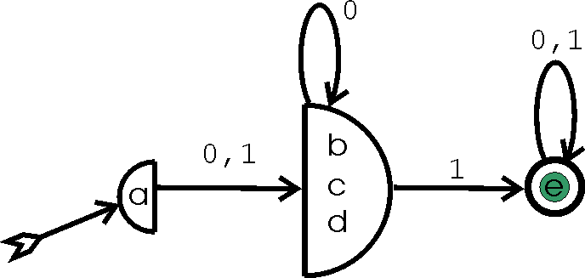
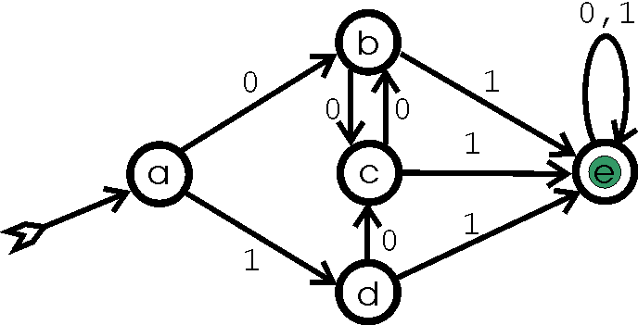
Practice yourself….

Slide 18
END

